Slide 1

CAIP Canada
Exam Prep Seminar:
Introduction to Your Mentor &
CAIP Canada
Robert A. G. Wong, CAIP, FCRIC
May 2020

Slide 2

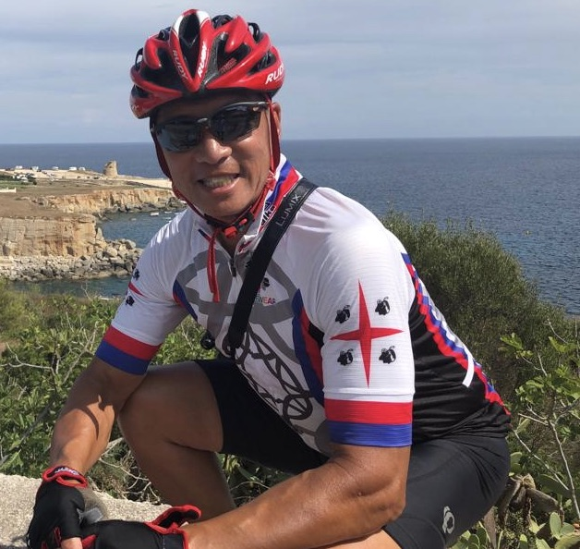


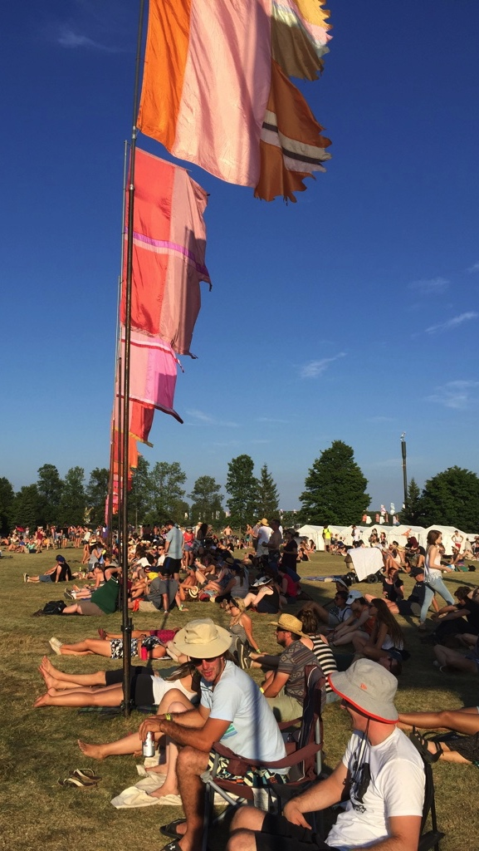
A Bit About Me
Robert Wong will be your mentor
  Love my career in research & strategic planning
  30+ years researching the “world”
  Retired Program Coordinator for Georgian College, Research Analyst (post-grad) program
  Principal of my boutique firm, RMCG Inc. since 1992
Specialized in Tourism
  Economic impacts of cycle tourism
  Georgian Bay Waterfront Trail Feasibility
  Collingwood Your Business Matters annual survey
  Blue Mountain Village summer visitor tracking
  Festival research: Boots and Hearts, Wayhome, Salsa, Elvis, Gran Fondo Lake Huron, Sea Otter Festival
Robert Wong, CAIP, FCRIC
E: robert@rmcg.ca
E: robert.wong@caip-paim.ca

Slide 3

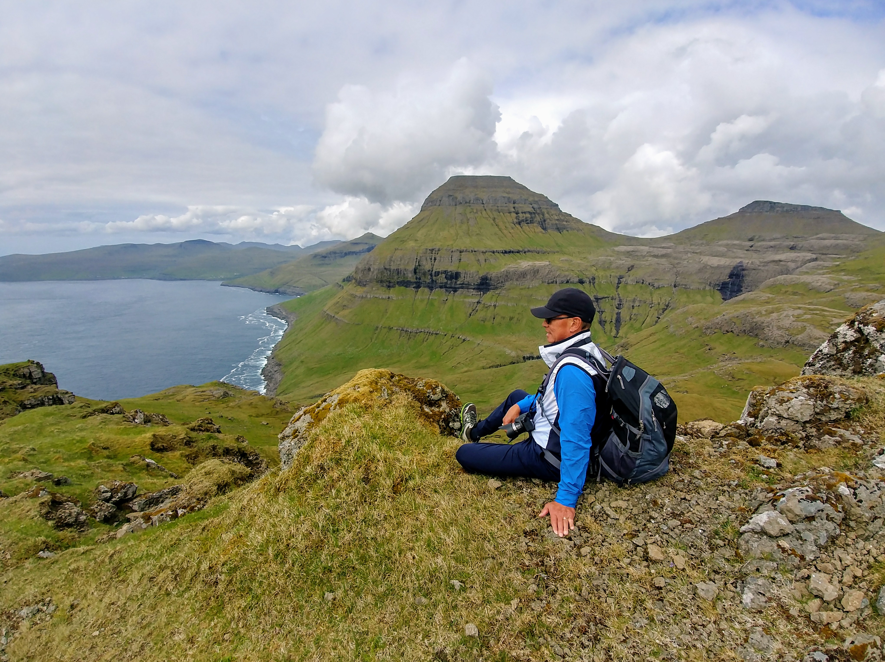

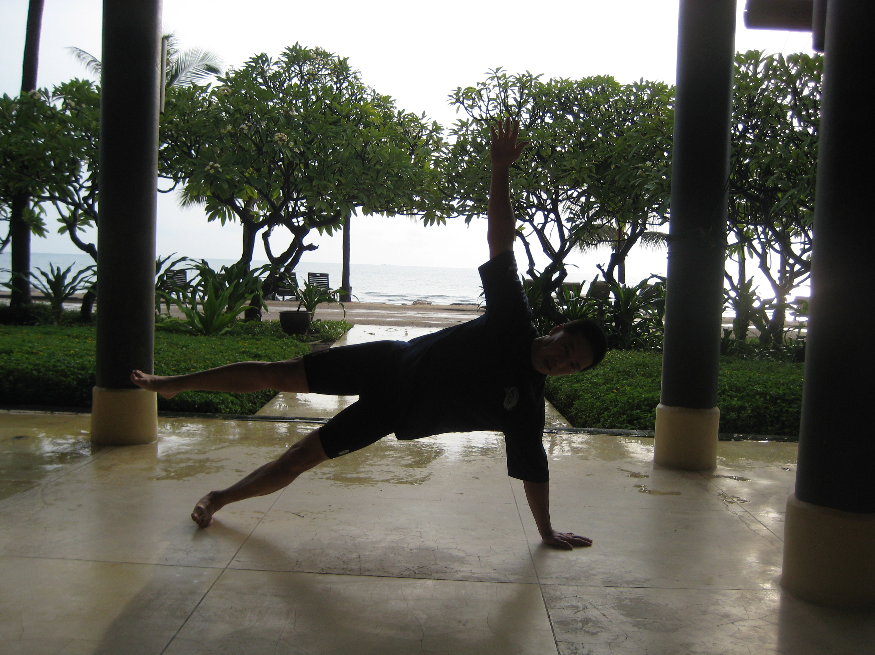
A Bit About Me
Social Issue Research
  Ontario Beekeepers Association, Federation of Ontario Bed & Breakfast Associations, Muskoka Cares: Labour Force Survey
Training:
  IESO, Honda Canada, AstraZeneca, CES
  MR industry training in Ecuador, Thailand & Germany
Volunteering
  CAIP Canada, CESO, DIVIBO, Saugeen Memorial Hospital Foundation
Just for Fun
  Road cycling, landscape photography, skiing, golf, perennial gardening and yoga to keep sane

Slide 4

The Certified Analytics and Insights Professionals of Canada (CAIP Canada) is the professional body for Canada's Certified Analytics and Insights Professionals (CAIPs). Its mission is to power the success of businesses and organizations by ensuring that CAIPs have the competencies needed to unlock the power of data while maintaining the highest ethical standards that protect the public trust.
CAIP Canada is supported by the Canadian Research Insights Council and the CAIP is globally endorsed by ESOMAR.
@Yuri Arcurs/iStock

Slide 5
Share A Bit About You
In the Chat do a bit of sharing about your story
Your current industry role
  Position, supplier/client/government?
  Type of day to day activities in research, analytics, insights
How did you start in research/analytics?
  Academic studies background
  Years in industry
Share motivation for earning your CAIP
@Yuri Arcurs/iStock

