Slide 1

CAIP Canada
Exam Prep Seminar:
Seminar Overview
Robert A. G. Wong, CAIP, FCRIC
May 2020

Slide 2


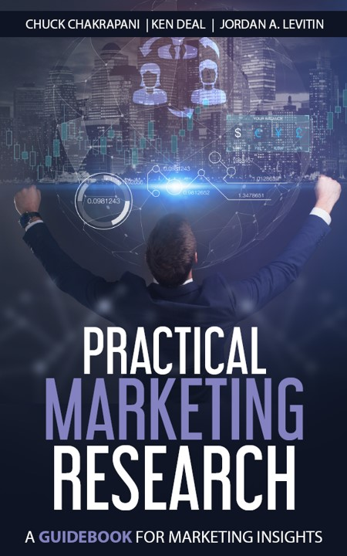
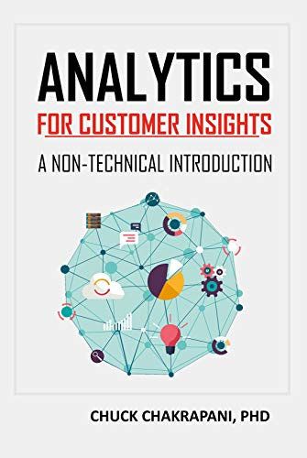


This “Exam Prep Seminar”
Will
  Exercise test writing skills
  Refresh the learning brain cells
  Help you to understand the CAIP Canada Competencies
  Build confidence – strengths & gaps
Won’t
  Guarantee success without your effort
  Teach you all the competencies materials
@Getty Images
Click logos to check out resources
Competency Framework.
Code on Market, Opinion & Social Research and Data Analytics

Slide 3

CAIP Canada Examination
Testing demonstrated competencies of a Certified Analytics and Insights Professional (CAIP)
Comprehensive, rigorous & fair exam in two parts
Written in two half days (3.5 hours each)
Part 1: Short Answer Exam
  Testing centres
  Computer with exam software
  About 20-30 questions
  70% pass threshold
Part 2: Project Proposal/Critique
  Application of research design
  Develop or critique project proposal
  70% pass threshold
@Adobe Stock

Slide 4

Keys to Success
Preparation
  Review ICC/ESOMAR Code on Market, Opinion & Social Research and Data Analytics
  Review CRIC Pledge to Canadians
  Practice with Prep Seminar practice questions for each of the Lessons
  Review & practice the development of and critique of research designs
  Work with peers, accept peer reviews, practice
Setup
  Set up computer for your comfort
  Set clock
  Statistics formula sheet provided
  Develop your summary memory notes (build acronyms to help you remember)
@iStock

Slide 5

Keys to Success
Question writing strategy
  Assess for relevant & irrelevant info
  Underline key information
  Determine the competency topic of question (e.g. sampling, questionnaire design, quantitative and qualitative methods, ethics and standards)
  Jot down points to layout answer
  Develop conclusive statement then provide evidence to back up
  Use bullets or a table to organize answer
  Match points to the marks
  Watch your time!!!
  Don’t over answer
@Adobe Stock

Slide 6
Peek At The Seminar
Self-paced, online, eight lessons with additional practice questions or cases, linear progression or customize to your needs
On set date, live online session to discuss Project Proposals/Critique with time for questions and answers
Quant Methods
Questionnaire Design
Analytics & Insights
Exam
Research Designs
Research Management
Project Proposal &
Critique
Qual Methods
Sampling
Ethics & Standards

Slide 7




Need to Prepare More?
Numerous practical training available
  In-house company training
  College & University programs
MRII offers two streams of online training leading to qualifying for certification
@Adobe Stock

Slide 8
Peek at Some Typical Questions

Slide 9
Exam Question Example 1
Hero Eats introduced a new protein snack made from acorns, called Cornies. You were involved in the preliminary product development research. It involved 12 online bulletin board focus groups (BBFGs) across Canada to examine reactions to the name, packaging, taste and nutritional values. The insights identified a keen interest among potential consumers about the nutritional properties and rave reviews about the taste.
Now 3 months later, the uptake in sales have been poor. The VP of Marketing is desperate to change the fortunes of this new product. She wishes to drive her digital advertising campaign and wishes to post verbatim written comments and video captures from the BBFGs about the taste.
In addition, she remembered that during the debrief there were comments by the staff following the discussion that 95% of participants really liked the product.
How would you reply to the VPs requests?

Slide 10
Underline & Identify Competencies Tested
Context
Hero Eats introduced a new protein snack made from acorns, called Cornies. Your firm was involved in the preliminary product development research.
It involved 12 online bulletin board focus groups (BBFGs) across Canada to examine reactions to the name, packaging, taste and nutritional values.
The insights demonstrated a keen interest among potential consumers about the nutritional properties and rave reviews about the taste.
Now 3 months later, the uptake in sales have been poor. The VP of Marketing is desperate to change the fortunes of this new product.
She wishes to drive her digital advertising campaign and wishes to post verbatim written comments and video captures from the BBFGs about the taste.
In addition, she remembered that during the debrief there were comments by the staff following the discussion that 95% of participants really liked the product.
How would you reply to the VP’s requests?
Methodology
Results
Issues
One question competencies tested

Slide 11
Underline & Identify Competencies Tested
Product development
Hero Eats introduced a new protein snack made from acorns, called Cornies. Your firm was involved in the preliminary product development research.
It involved 12 online bulletin board focus groups (BBFGs) across Canada to examine reactions to the name, packaging, taste and nutritional values.
The insights identified a keen interest among potential consumers about the nutritional properties and rave reviews about the taste.
Now 3 months later, the uptake in sales have been poor. The VP of Marketing is desperate to change the fortunes of this new product.
She wishes to drive her digital advertising campaign and wishes to post verbatim written comments and video captures from the BBFGs about the taste.
In addition, she remembered that during the debrief there were comments by the staff following the discussion that 95% of participants really liked the product.
How would you reply to the VP’s requests? What further research suggestions might you offer and why?
Qual methodology
Issues
One question, two issues: use of qual results, standards & back up

Slide 12
Underline & Identify Competencies Tested
Hero Eats introduced a new protein snack made from acorns, called Cornies. Your firm was involved in the preliminary product development research.
It involved 12 online bulletin board focus groups (BBFGs) across Canada to examine reactions to the name, packaging, taste and nutritional values.
The insights identified a keen interest among potential consumers about the nutritional properties and raved reviews about the taste.
Now 3 months later, the uptake in sales have been poor. The VP of Marketing is desperate to change the fortunes of this new product.
She wishes to drive her digital advertising campaign and wishes to post verbatim written comments and video captures from the BBFGs about the taste.
In addition, she remembered that during the debrief there were comments by the staff following the discussion that 95% of participants really liked the product.
How would you reply to the VP’s requests?
Response:
Competency tested about use of qual results & code of conduct
Answer Directly:
No, use of respondent videos cannot be used for marketing purposes. This is an example of MUGGING – marketing under the disguise of research
Qual research is more about exploring and cannot be reported in quantitative terms.
Lesson Learned:
Answer competency question and back up answer
Marks: 2!

Slide 13

Exam Question Example 2
OMG health unit contracted your firm to conduct a study of alcohol consumption among under age drinkers attending high school.
What sort of consent is necessary to be ethical and meet the ESOMAR/CRIC standards? Who should be informed in order to obtain consent (which might then be withheld?)
Would the social benefits attached to the study create a special case for access to students?
@Dreamstime

Slide 14
Exam Question Example 2
OMG health unit contracted your firm to conduct a study of alcohol consumption among under age drinkers attending high school.
What sort of consent is necessary to be ethical and meet the ESOMAR/CRIC standards? Who should be informed in order to obtain consent (which might then be withheld?)
Would the social benefits attached to the study create a special case for access to students?
Context
Competency tested

Slide 15
Exam Question Example 2
Research with young people under 18
OMG health unit contracted your firm to conduct a study of alcohol consumption among under age drinkers attending high school.
What sort of consent is necessary to be ethical and meet the ESOMAR/CRIC standards? Who should be informed in order to obtain consent (which might then be withheld?)
Would the social benefits attached to the study create a special case for access to students?
Ethics & standards

Slide 16
Exam Question Example 2
Response:
Competency tested ethics and standards with young people
Answer Directly:
Permission must come directly from the parent/guardian of the children. Neither the school’s nor the teachers’ would be enough.
The social benefits would not over-ride the need to obtain parental permission because a child could suffer psychologically & physically as a result of the research.
Lesson Learned:
Answer competency question and back up answer
Marks: 2!
OMG health unit contracted your firm to conduct a study of alcohol consumption among under age drinkers attending high school.
What sort of consent is necessary to be ethical and meet the ESOMAR/CRIC standards? Who should be informed in order to obtain consent (which might then be withheld?)
Would the social benefits attached to the study create a special case for access to students?

Slide 17
Time To Examine Competencies
Choose to follow the order of lessons or pick and choose where your skills could be refreshed

