Slide 1


CAIP Canada
Exam Prep Seminar:
Qualitative Methods
Robert A. G. Wong, CAIP, FCRIC
May 2020

Slide 2
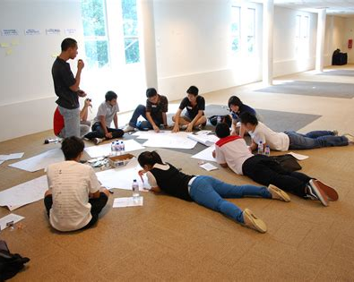
Qualitative Research
Qual
Methods
Why Qualitative?
Qualitative Methods
Peek at Some Methods
  Focus Groups
  BBFGs
  In-depth Interviews
  Screeners & Discussion Guides
Example Questions
Thematic Analysis
@humansofdata

Slide 3
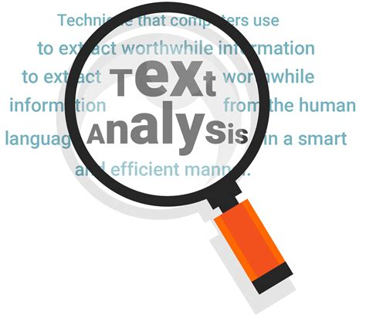
Qualitative Collection Methods
Qual
Methods
Qualitative
  Small number of sample
  Need in-depth information about an issue
  Exploratory
  Unsure of the options
  Need to understand perceptions
  Explore the range of ideas not to determine the most preferred
  An approach perspective, a way to view
@Adobe Stock

Slide 4
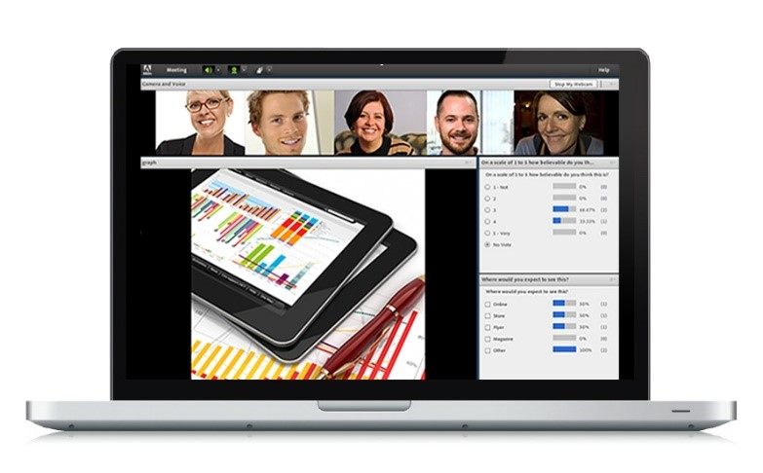
Comparison of Methods
Qual Methods
Method | Info Quality | Participant Convenience | Turn-around | Bias | Analysis | Cost
Observation | moderate | high | moderate to slow | moderate to high | moderate | moderate
In-depth interviews | high | moderate | slow | moderate to low | more difficult | high
Focus groups (live) | moderate to high | moderate to low | moderate to slow | moderate to low | more difficult | high
Focus groups (online) | moderate to high | moderate | moderate to slow | moderate to low | moderate | moderate
Ethnographic studies | moderate to high | moderate to low | slow | moderate | more difficult | high
Emerging techniques- blog, twitter | ? | ? | ? | ? | ? | ?
@Shutter Stock

Slide 5


Consider Emerging Techniques
Qual Methods
Ethnographic Studies
  Ikea Shoppers Ethnographic case study
Social Media analysis
Click to check out this case study
Click to check out what IBM thinks

Slide 6
Examine Focus Groups in More Depth
Qual Methods

Slide 7

Moderator’s Role
Qual Methods
Introduction
  Consent, audio & video recording, people behind the glass
Facilitate and probe
Set tone, relaxed, manage meek and divide the strong
Great listener, probes but not necessarily a specialist about the topic
Bag of tools, know when to use them
Manage back for the room
  Not to quantify the qual, other things?
  Debriefing after groups?
@Adobe Stock

Slide 8
Moderator’s Tool Bag
Top 10 techniques for online qual
Qual Methods
How have things changed?
Bag of tools, know when to use them
  Phrasing questions to encourage discussion
  Employing projective technique where useful?
  Handling vocal participants?
  Encouraging those not participating?
Why projective techniques?

Slide 9

BBFG (Bulletin Board Focus Groups)
Qual Methods
BBFGs
  Online, asynchronous, variety of features from use of video, chats, whiteboards and mark ups
  Ability to schedule questions and more
Pros
  Online allows for greater geographical coverage
  Both synchronous and asynchronous for convenience
  Use media to show images and videos
  Facility and refreshment costs savings
  Transcripts available immediately
Cons
  More effort to engage participants
  Smaller number (4-8) participants due to following threads
  Skilled moderator and must be active frequently
  Expense of online qual platform

Slide 10
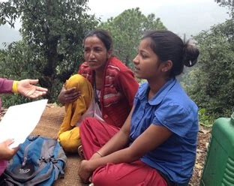
In-depth Interviews & Groups
Qual Methods
Semi-structured interview guide
  Topics laid out
  Potential sequence
  Adaptable to flow of conversation
  Items to probe
Open-ended questions
  Verbs absolutely important
    Describe, explain, tell us about, share thoughts
    Exploring responses NOT forcing answers
    Range of ideas more important than frequency count

Slide 11

Screeners and Discussion Guides
Qual Methods
Screeners
  Set realistic criteria to identify eligible participants
  Tight criteria to match ideal sample but not too complicated to identify and recruit
  Criteria might be profile characteristics or past behavior (e.g. primary online shopper in household, own a fitness membership with use at least twice a week)
  Remember standards to eliminate ”professional respondents”.

Slide 12

Screeners and Discussion Guides
Qual Methods
Discussion Guides
  Consider pyramid or funnel sequencing
  Open-ended questions with ideas for probing
  Strong and engaging opener and a wrap up closure
  Consider broad topics to be covered
  Consider techniques to draw out the meek and manage dominant participants
  Remember the standards for participants’ rights to full disclosure of privacy and data security
@Adobe Stock

Slide 13

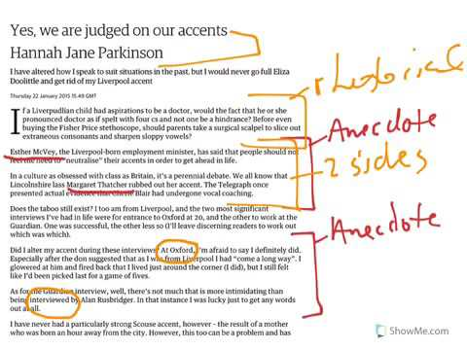
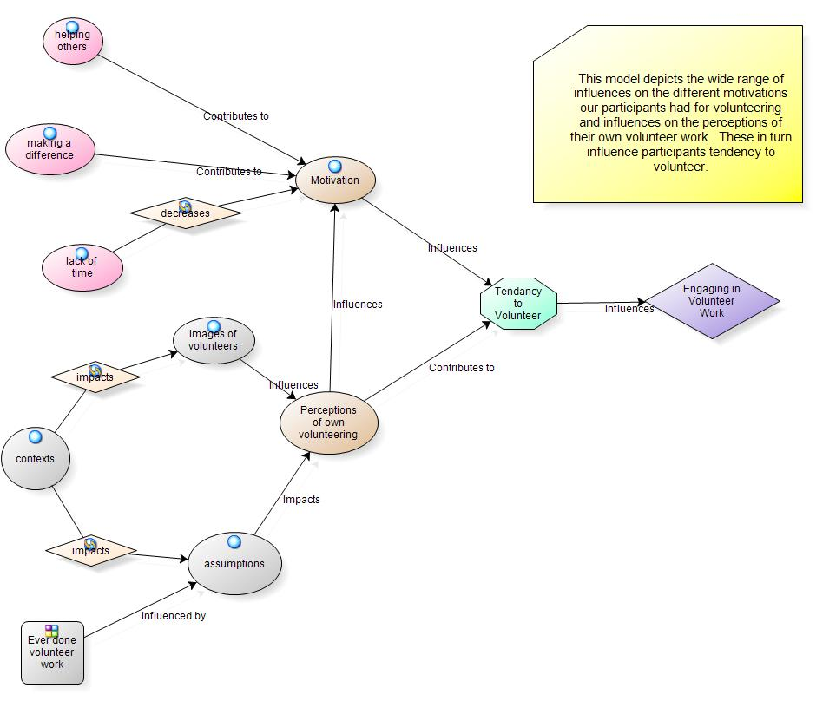
Thematic Analysis
Qual Methods
Peek at Thematic Analysis-hands-on technique (3 min)
  Familiarize with your data
  Generate initial codes
  Search for themes
  Reviewing themes
  Defining & renaming themes
  Prepare report
Qualitative Analysis software (8 min)
  E.g. NVivo –Intro to Nvivo data analysis software
Check out this video
Check out this video

Slide 14
Your Turn!

Slide 15
What’s Up Next?
Quant Methods
Questionnaire Design
Analytics & Insights
Exam
Research Designs
Research Management
Project Proposal &
Critique
Qual Methods
Sampling
Ethics & Standards

