Slide 1


CAIP Canada
Exam Prep Seminar:
Qualitative Methods:
Practice Questions
Robert A. G. Wong, CAIP, FCRIC
May 2020

Slide 2
Before you begin!
Reminders
Underline
Identify competency being tested
Examine marks for question
Prepare answer directly & back up!!!

Slide 3
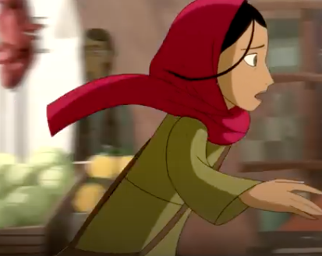
Prepare Screener and Guide
Qual Methods
FILM: Films in Learning Matters
A local community film festival group has offered an Educational Program for schools in the region. Elementary and secondary teachers are contacted in the fall about potential screening of films that could complement the curricula. The Film Festival sees an opportunity to expand the educational program (e.g. more films, greater range of subjects, more value for teachers) to bring films to a greater number of students.
As the Research Coordinator for the regional school board you have taken on this project. The Film Festival has asked to see a draft screener so they can recruit teachers for an online focus group and a draft discussion guide.
@The Breadwinner

Slide 4

Underline & Identify Competencies Tested
Qual Methods
FILM: Films in Learning Matters
A local community film festival group has offered an Educational Program for schools in the region. Elementary and secondary teachers are contacted in the fall about potential screening of films that could complement the curricula. The Film Festival sees an opportunity to expand the educational program (e.g. more films, greater range of subjects, more value for teachers) to bring films to a greater number of students.
As the Research Coordinator for the regional school board you have taken on this project. The Film Festival has asked to see a draft screener so they can recruit teachers for an online focus group and a draft discussion guide.

Slide 5

Prepare Screener and Guide
Qual Methods
Practice with this case
  Time yourself for 15 minutes, Total marks 6
  Consider what you need to demonstrate for an exam (6 marks)
Screener
Discussion Guide

Slide 6
Another Example Question
Qual Methods
Provide an example of a small group projective technique to understand teachers’ barriers to incorporating films for learning
Briefly describe technique in context (1 mark)
Explain expected outcomes (1 mark)

Slide 7
Compare and Contrast Live vs Online Groups
Qual Methods
Same FILM case
  Time yourself for 10 minutes, Total marks 4
  Consider what you need to demonstrate for an exam (4 marks)
Live Focus Groups
Pros:
Cons:
Online Focus Groups
Pros:
Cons:

Slide 8
Now check out CAIP L2.3 for Discussion & Feedback

Slide 9
What’s Up Next?
Quant Methods
Survey Design
Analytics & Insights
Exam
ResearchManagement
Project Proposal &
Critique
Research Designs
Qual Methods
Sampling
Standards & Ethics

