Slide 1


CAIP Canada
Exam Prep Seminar:
Questionnaire “Survey” Design
Robert A. G. Wong, CAIP, FCRIC
May 2020

Slide 2


Questionnaire Design
Survey Design
“Survey”
Steps
  Operationalize
  Question Wording
  Design for Modality
  Test & Refinement
Type of Questions
Common Wording Errors
Design Considerations
Example Questions

Slide 3
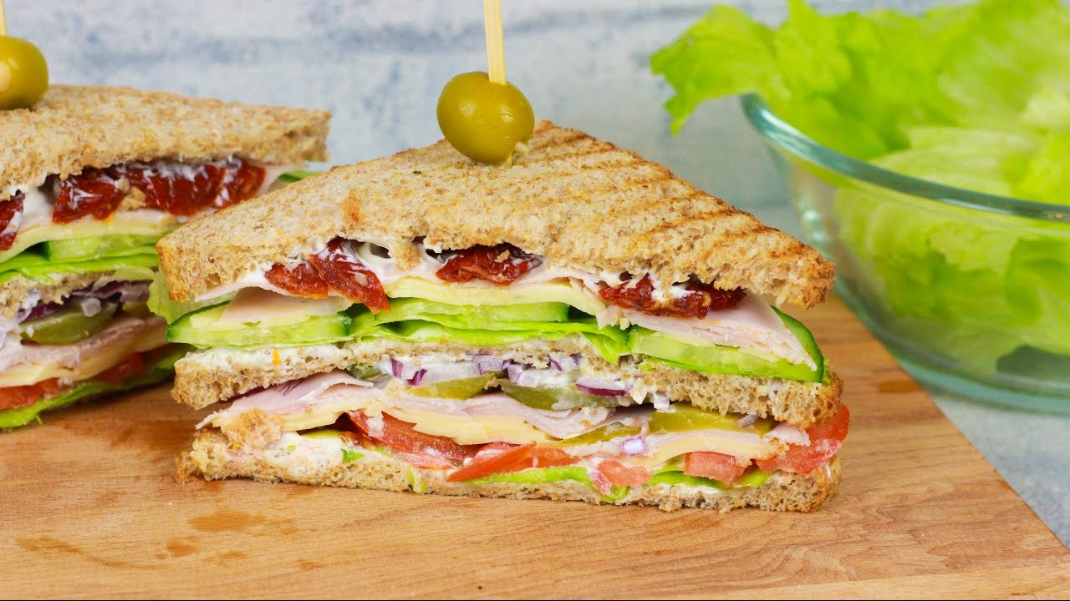
The Sandwich
Screening, warm up, easy to answer, behaviour
Survey Design
Classification (demo-geo)
Main section (attitudes, preferences, ranking)

Slide 4
Types of Questions
Survey Design
Open-Ended
  When? To explore
    Don’t know the answers
    Learn their words
    Unprompted response
  Advantages
    Easier to write
    Less space
  Challenges?
    Understanding
    Analysis
    Participation
  Verbs very important
    Describe, tell, share
Closed-Ended
  When? Quantity
    Know range
    Finite measurements
  Advantages
    Easier for respondents
    Easier to analyze
    Know what you are measuring
  Challenges
    Validating range
    Loaded responses, bias
    Takes more space
    Measurement scales
      I R N O
      Order of lowest to highest level of detail ??

Slide 5

Have some fun!
Take a topic!
Maybe travel, school, working from home, anything
Interview a friend/family member
BUT design your four question interview with OPEN Questions and then CLOSED-ENDED Questions
Then try it out!
Survey Design

Slide 6
Types of Questions
Survey Design
Strongly agree
+3
+2
+1
-1
-2
-3
Which scale is which?
  Likert scale
  Numeric rating scales
  Stapel scale
  Semantic differential scale
  Goal attainment scale (GAS)
Strongly disagree
Strongly disagree
Strongly agree
1 2 3 4 5 6 7
1 2 3 4 5 6 7
dependable
undependable
completely dissatisfied somewhat dissatisfied somewhat satisfied completely satisfied

Slide 7
Types of Questions
Survey Design
Strongly agree
+3
+2
+1
-1
-2
-3
Which scale is which?
  Likert scale
  Numeric rating scales
  Stapel scale
  Semantic differential scale
  Goal attainment scale (GAS)
Strongly disagree
Strongly disagree
Strongly agree
1 2 3 4 5 6 7
1 2 3 4 5 6 7
dependable
undependable
completely dissatisfied somewhat dissatisfied somewhat satisfied completely satisfied

Slide 8
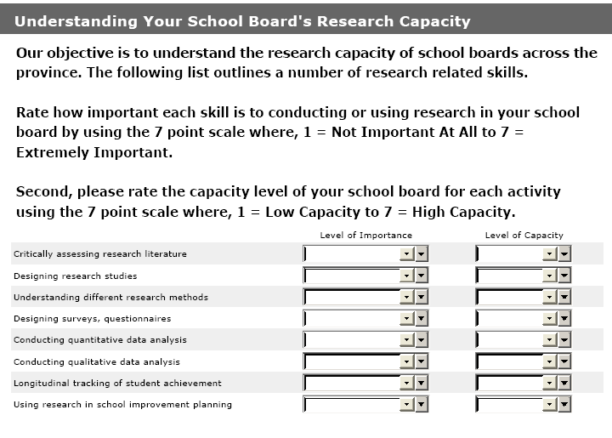
Goal Attainment Scale
Survey Design

Slide 9
What might it look like?
Survey Design
Using Research
Design Surveys
Qual Data Analysis
HL
HH
Assessing Lit
Quant Data Analysis
Different Methods
Importance
LL
LH

Slide 10

Writing Question for Measurement Scale
Survey Design
Try to collect highest order when possible (always able to collapse)
Let’s examine Age as a variable
  Nominal - just categories, no mathematical relationship
  Ordinal – relationship but no magnitude
  Interval – Relationship & magnitude (twice as old)
  Ratio – Relationship & zero has a meaning
Write a question about age for each measurement
@Maskot/Adobe Stock

Slide 11
Writing Question for Measurement Scale
Survey Design
Let’s examine Age as a variable
  Nominal – Are you over 18?
          Yes No
  Ordinal – Which age group do you fall within?
    Under 18 18-34 35-44 45-74 75 or older
  Interval – Into which age group do you fall?
    Under 18 18-34 35-44 45-54 55-64 65-74 75 or older
  Ratio – Please tell us your age?
        ________ years

Slide 12
Wording Challenges
Survey Design
Collectively exhaustive
  All possible choices offered
  Use “other” as an option but be prepared for high response if not well thought out
Mutually exclusive
  No overlapping categories
    Age 20-30 30-40 40-50
    What type of vehicle do you drive?
      Mazda, SUV, Compact, Flex, Fiat
Vague Questions
  Need context of situation such as timeframe
    How often do you bike?
      Mtn, road, gravel
      During a week, season, holidays
      In B.C. or anywhere
    None, few times, a little, some, lots
  Undecided & Don’t Know mean different things

Slide 13
Wording Challenges
Survey Design
Loaded response scales
  Tremendous, excellent, very good, good, poor
  Don’t need to invent, many examples in public domain
completely disagree somewhat disagree somewhat agree completely agree
not important at all somewhat unimportant somewhat important very important
completely dissatisfied somewhat dissatisfied somewhat satisfied completely satisfied
definitely no probably no probably yes definitely yes

Slide 14
Wording Challenges
Survey Design
Loaded questions
  Especially on attitude statements and must be careful of double negative
    “Avoiding an anti-racist organization is not a priority for me”
  Intermix the statements to avoid straight liners
  Ask matching questions
    What one likes?
    What one dislikes?
  Randomize or rotate response categories
Double-barreled questions
  Easier to spot on key words such as helpfulness and courteous
  More difficult to spot in a statement
    I just need time! I need time for myself as well as quality time with my child
Contingency questions
  Sometimes you can combine two questions into one:
  Is this your first visit to this store?
  How many times do you visit in a season?
  How many times have you visited the store in the past season?
  My first time 2 3-5 6-10

Slide 15
Wording Challenges
Survey Design
Validity
  Measuring what you want to measure
  Economic impact
    How many days? vs How many nights?
Reliability
  Consistency
  Using common attitude scales
  Which diagram represents:
    High validity & high reliability?
    Low validity & high reliability?
    Low validity & low reliability?
Sensitivity
  Detail of the range of responses
  1-10 scale, 1-7, 1-4 vs 1-5
  Measure degree of differences vs opposites
  How long have you lived in Toronto?
    <3 4-5 6-9 10+
    Not sensitive in high end for further subgroup analysis

Slide 16
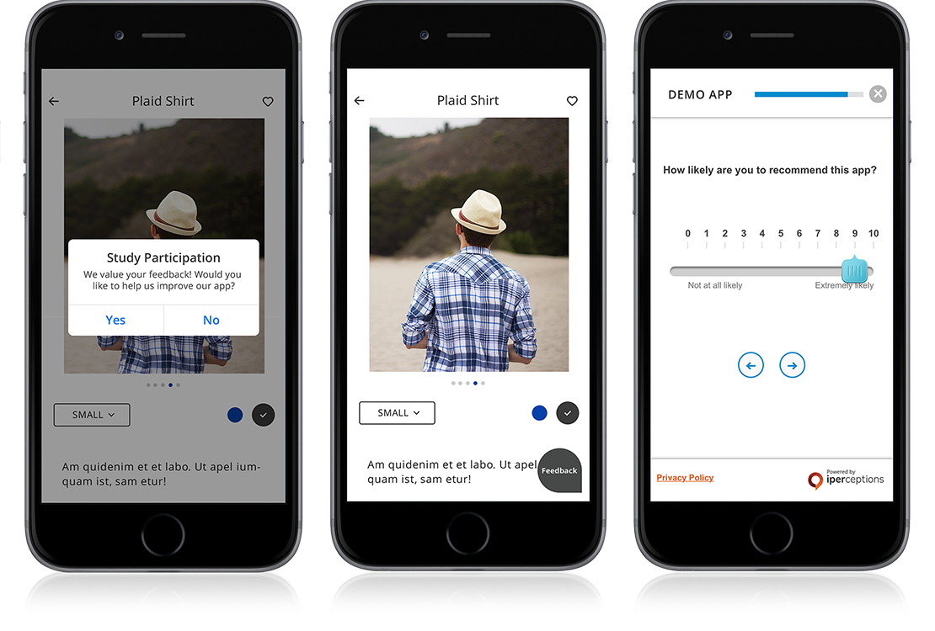
Design for Impact
Survey Design
Worthy Considerations
Modality
Logical flow/sections
Space efficiency
Consistency of scales & direction of scales
Clarity of instructions
Spacious
Easy and enjoyable experience
Professional & worth of a response
Pretest and Pilots
Length
Wording/spelling & grammar
Instructions
Skip patterns/piping

Slide 17
Design for Mobile (Mobile Optimization)
Survey Design
Why important
  When respondents are provided the option to complete surveys on mobile or desktop/laptop, 30%+ opt to complete them on mobile
  With no mobile option, some groups in sample not represented, and the sample may be biased
Optimizing surveys for mobile impacts the overall design
  10-point scales do not work well on mobile screens, so forced to using 7 or less points scales
  Grids with more than 3 or 4 columns and 4 to 5 rows do not fit on the screen in one view.
  Questionnaire could feel longer resulting in early termination
  Showing visuals, logos, packages are tricky given the size of visual on the screen and risk of viewer missing important details on the visuals.

Slide 18
Questionnaire Critique Time

Slide 19
What’s Up Next?
Quant Methods
Questionnaire Design
Analytics & Insights
Exam
Research Designs
Research Management
Project Proposal &
Critique
Qual Methods
Sampling
Ethics & Standards

