Slide 1


CAIP Canada
Exam Prep Seminar:
Research Management
Robert A. G. Wong, CAIP, FCRIC
July 2020

Slide 2

Marketing Management
Research creates value by minimizing risk and maximizing benefits
Recognize different management issues
Recognize different research approaches
Examine your role
@stockfour/Shutterstock

Slide 3

Value of Marketing Research
Management
@Tempura/iStock
Research can guide marketing functions such as:
  Right product or service,
  At the right price
  In the right place
  With the right communication
Common marketing issues:
  Consumer understanding
  Marketing landscape and brand equity
  Innovation development
  Marketing communications
  Go-to-market tactics (pricing, packaging)
  Specialized fields such as pharmaceutical, and political opinion polling)

Slide 4

Begins with Understanding of
Client’s Needs
Management
Many forms of research including no research at all
  Researcher’s role to understand client’s needs
  Could be different than what is requested
  Logical enquiry:
    What is the client’s prime business?
    Who needs the information?
    What decisions are they wanting to make?
    What are the risks of making a wrong decision?
    Has past research been conducted and was it informative?
  Overall then:
    Would research provide new information and insight to the client’s needs?
@skupicoo/iStock

Slide 5
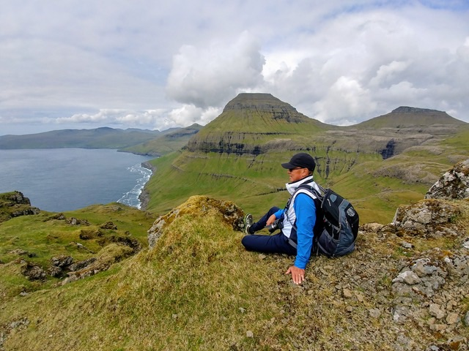
A Peek: Consumer Understanding
Management
Consumer Understanding
  U&A/A&U or H&A – Usage and Attitude, Habit and Attitude
  Your turn
    Past behavioural questions:
      Think about questions regarding decisions to dine out at a restaurant or about a choice of a family travel destination.
    Then build attitudinal scaled question:
      For your topic, what might be your questions?
@rmcg

Slide 6






Potential Analytics and Insights
Management
Management
Correlation analysis
  Degree to which two items are related
  Maybe satisfaction & purchasing behaviour
Factor analysis & principal component analysis
  Data reduction technique of attitudes to discover some key underlying themes represented by groups of attitudes
Cluster analysis
  Technique to divide consumers/population into manageable clusters (e.g. Environics Analytics PRIZM2 Lifestyle Clusters)
@Environics Analytics

Slide 7
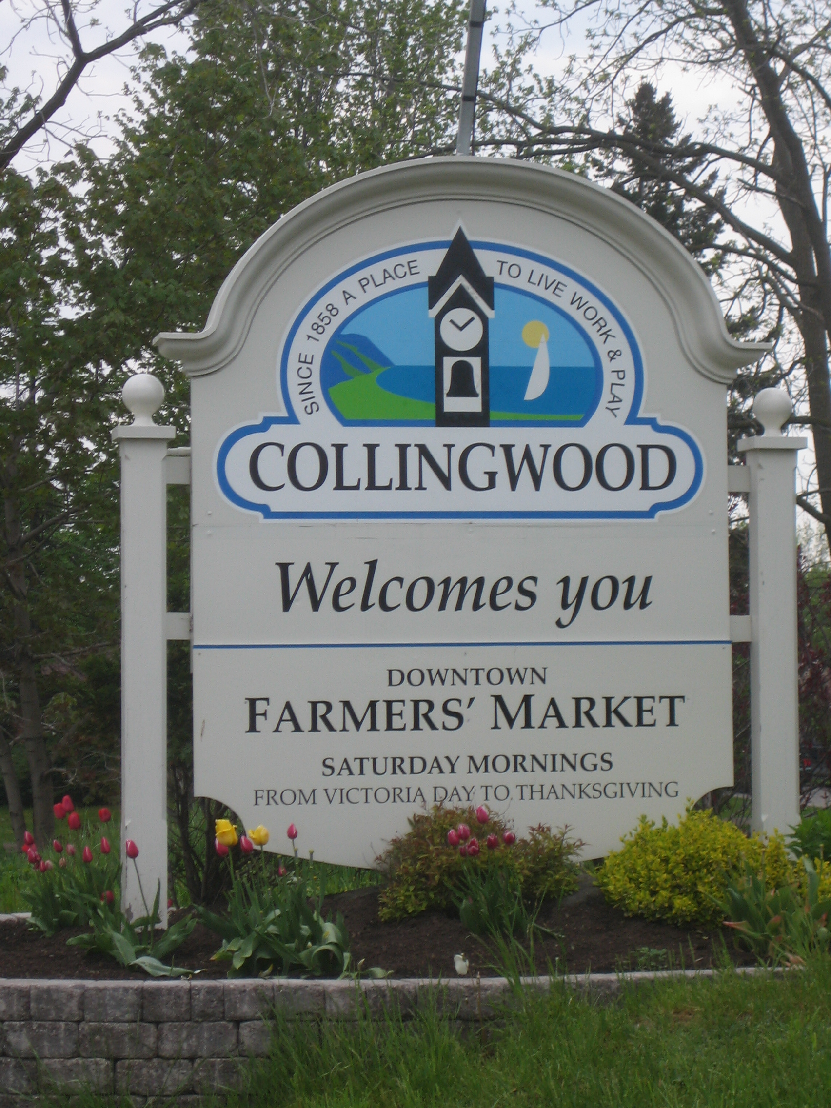
Peek: Market Landscape & Brand Equity
Management
Management Issue:
  Downtown BIA was facing increased competition with new resort Village, box stores along a major corridor and nearby communities maturing
  BIA wanted to entice more patrons to visit and shop in the downtown more often
Source: RMCG Inc, Collingwood Downtown Image Research, 2005

Slide 8
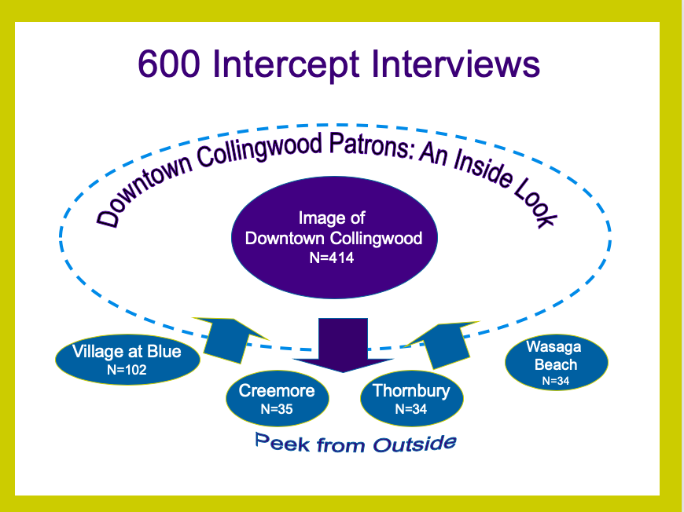
Research Methodology
MCAPI intercepts in Downtown Collingwood and four neighbouring communities
Asked about the visitation patterns, images and experiences of all five communities
Source: RMCG Inc, Collingwood Downtown Image Research, 2005

Slide 9
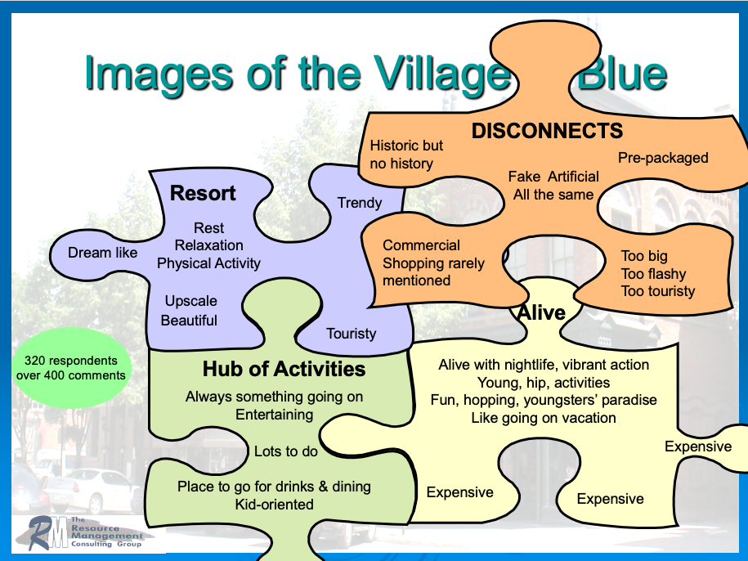
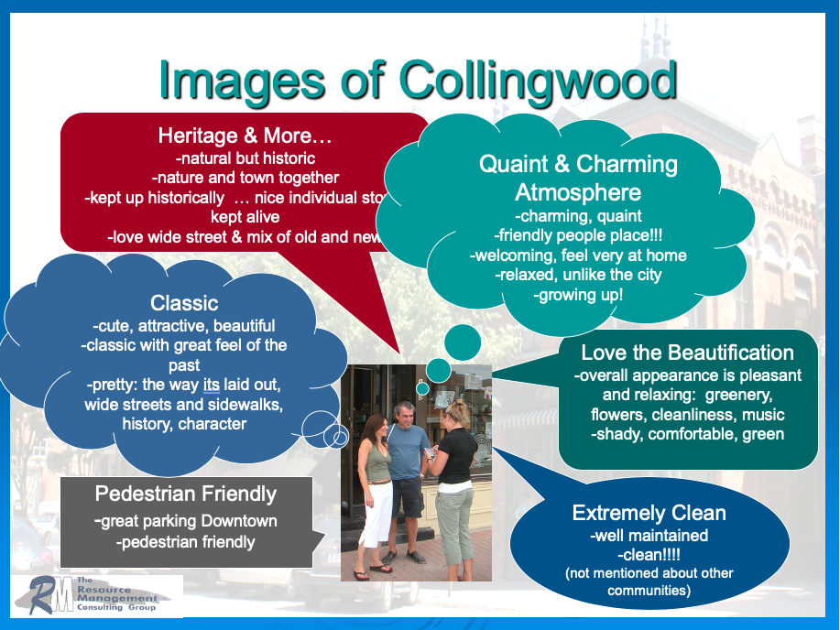
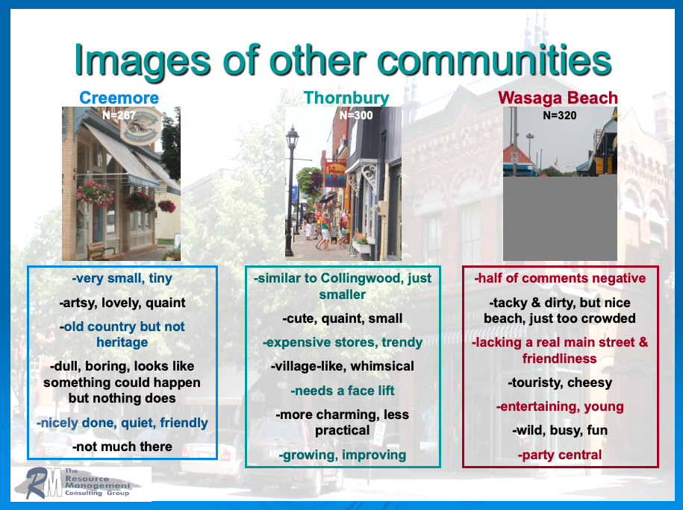
Source: RMCG Inc, Collingwood Downtown Image Research, 2005

Slide 10


Information to Insights
Management
Positioning
your product in the minds of customers & potential customers
  Know how customers/potential customers perceive & act
  Understand the competition
  Focus on needs/expectations of customers/potential customers
  Less is more
Branding
is a concerted communications/advertising campaign based on your positioning
  Brand = the one message that you want remembered

Slide 11
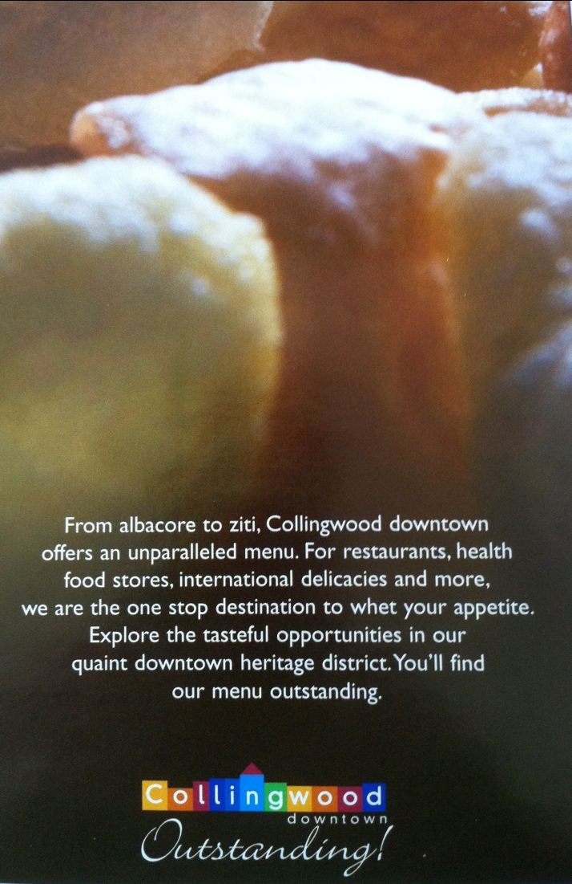
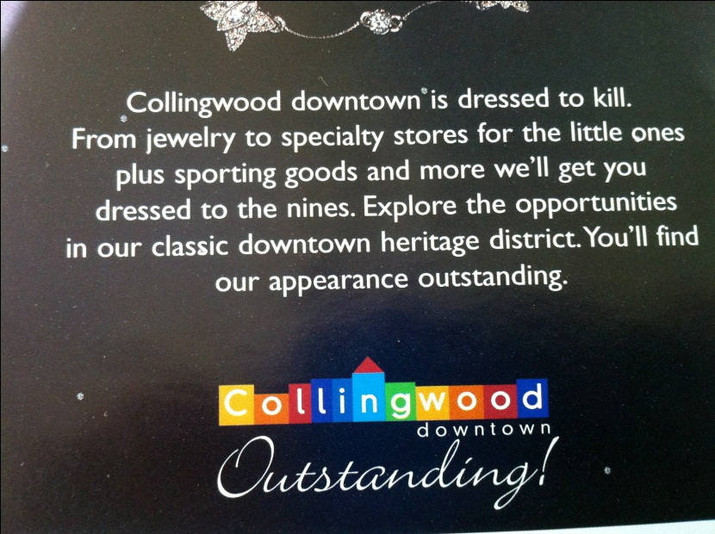
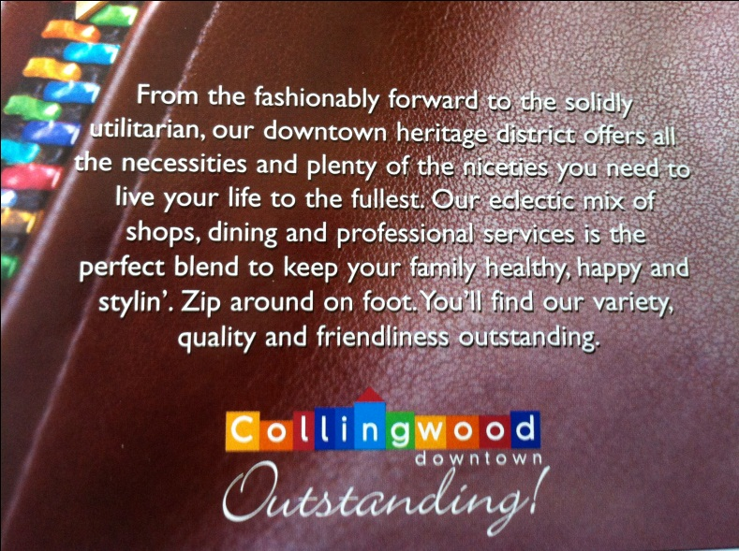

Slide 12
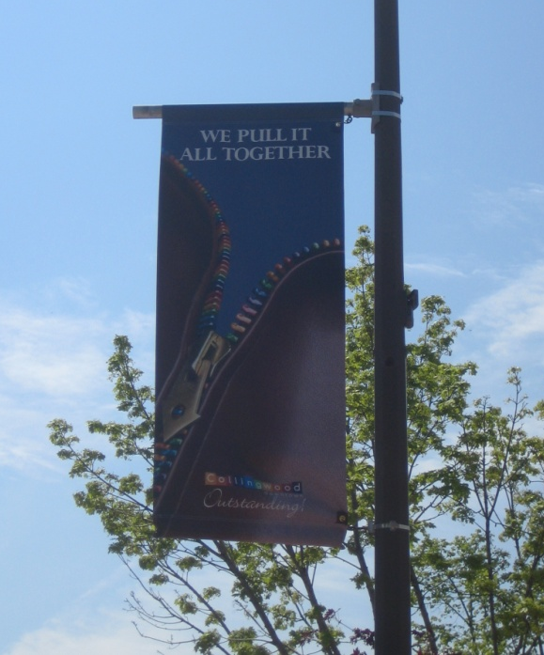
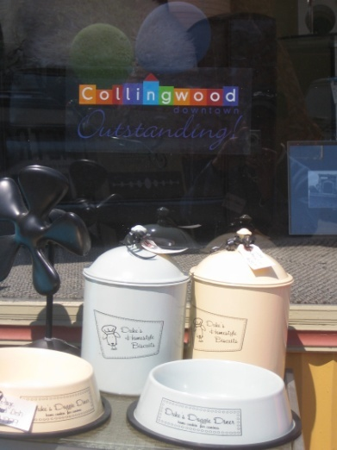
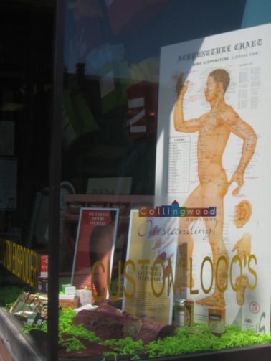
Branding at Work!

Slide 13
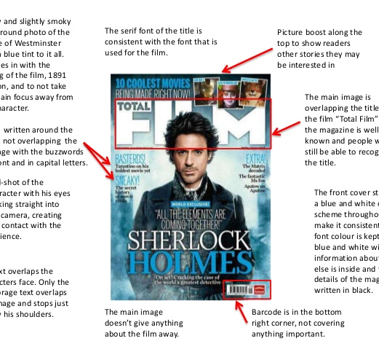
A Peek: Marketing Communications
Management
Promotion is to influence an expected objective
  Short term effects such as increased awareness or persuade a repurchase of the same product/service
  Long term effects such as reinforce consistent recognizable brand image
Research to measure the effect
  Consumer intercepts to measure awareness, recall, associated images
  Telephone tracking studies to measure pre & post campaign – awareness, image recall, call to action
  Online research – show media ads and query reactions to ads

Slide 14

Your Role as Analytics & Insights Professionals
@Yuri_Arcura/iStock

Slide 15

CAIPs’ Responsibilities
Respect & cooperation of public
As colleagues…client & supplier sides - financially responsible (“scope creep”)
  Mentorships & reverse mentorships
As clients…clients, sub-consultant specialists
  Full range of opportunities from government, political parties, not-for-profit, retailers, media, industry associations, law firms
  Relationships as partnerships in insight development
As providers…internally & externally
  CAIPs should stay informed, be effective communicators, develop realistic costings, ensure quality management, analyze thoughtfully
@demaerre/iStock
Professionalism, ethics, responsibility and establishing and maintaining good relations are core to the success of the research, insights and analytics industry
Source: Chakrapani, C & Deal, K. Modern Marketing Research Step-by-Step, Chapter 12, online July 2020

Slide 16
Your Turn Now!
Practice Questions

Slide 17
What’s Up Next?
Quant Methods
Questionnaire Design
Analytics & Insights
Exam
Research Designs
Research Management
Project Proposal &
Critique
Qual Methods
Sampling
Ethics & Standards

