Slide 1


CAIP Canada
Exam Prep Seminar:
Analytics & Insight
Robert A. G. Wong, CAIP, FCRIC
July 2020

Slide 2

Analytics and Insights
NOT a statistical exam but how analytics and insights utilizes statistics
Moving from data, analysis to insights
Understanding when to use different analytical techniques
Understand how to interpret statistical results
Building insights
@alexskopje/Adobe Stock

Slide 3
Data, Data and More Data
Analytics& Insights
Patterning
Cleaning
Data
Filtering

Slide 4
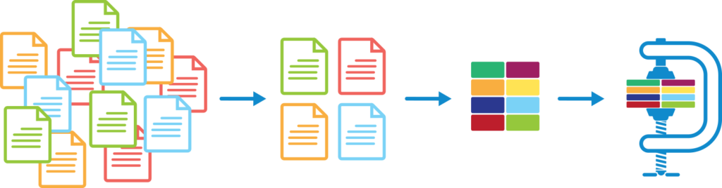
Analysis Process
Analytics& Insights
Analysis is involved with both numeric and textual data and most times it is the combination of both that leads to great insight and a stronger story

Slide 5

Interpret this: How was Canada doing?
Country | Total Cases | New cases | Total Deaths
Canada | 107,807 | 217 | 8,787
Interpret this: How was Canada doing?
Country | Total Cases | New cases | Total Deaths
Canada | 107,807 | 217 | 8,787
Australia | 9,980 | 108 | 108
Japan | 22,220 | 352 | 319
Source: July 15, 2020 https://www.worldometers.info/coronavirus/

Slide 6
Analytics& Insights
Interpret this: How was Canada doing?
Country | Total Cases | New cases | Total Deaths | Total Cases/1M Pop | Total Deaths/1M Pop | Total Tests/1 M Pop | Population (Millions)
Canada | 107,807 | 217 | 8,787 | 2,856 | 233 | 85,104 | 38
Australia | 9,980 | 108 | 108 | 391 | 4 | 121,974 | 25
Japan | 22,220 | 352 | 319 | 176 | 8 | 4,542 | 126
Source: July 15, 2020 https://www.worldometers.info/coronavirus/

Slide 7
Analytics& Insights
Interpret this: How was Canada doing?
Country | Total Cases | New cases | Total Deaths | Total Cases/1M Pop | Total Deaths/1M Pop | Total Tests/1 M Pop | Population (Millions)
Canada | 107,807 | 217 | 8,787 | 2,856 | 233 | 85,104 | 38
USA | 3,476,836 | 62,841 | 138,199 | 10,502 | 417 | 130,637 | 331
Brazil | 1,887,959 | 21,783 | 72,921 | 8,880 | 343 | 21,508 | 221
India | 907,645 | 26,179 | 23,727 | 658 | 17 | 8,553 | 1,380
Source: July 15, 2020 https://www.worldometers.info/coronavirus/

Slide 8
Interpret this: How was Canada doing?
Country | Total Cases | New cases | Total Deaths | Total Cases/1M Pop | Total Deaths/1M Pop | Total Tests/1 M Pop | Population (Millions)
Canada | 107,807 | 217 | 8,787 | 2,856 | 233 | 85,104 | 38
Australia | 9,980 | 108 | 108 | 391 | 4 | 121,974 | 25
Japan | 22,220 | 352 | 319 | 176 | 8 | 4,542 | 126
Germany | 200,436 | 486 | 9,139 | 2,392 | 109 | 76,093 | 84
Argentina | 103,265 | 3,099 | 1,903 | 2,284 | 42 | 474,422 | 45
USA | 3,476,836 | 62,841 | 138,199 | 10,502 | 417 | 130,637 | 331
Brazil | 1,887,959 | 21,783 | 72,921 | 8,880 | 343 | 21,508 | 221
India | 907,645 | 26,179 | 23,727 | 658 | 17 | 8,553 | 1,380
Source: July 15, 2020 https://www.worldometers.info/coronavirus/

Slide 9
Analysis
Context is invaluable to tell a full story.
 | Country | Total Cases | New cases | Total Deaths | Total Cases/1M Pop | Total Deaths/1M Pop | Total Tests/1M Pop | Population (Millions)
 | Canada | 107,807 | 217 | 8,787 | 2,856 | 233 | 85,104 | 38
Better | Australia | 9,980 | 108 | 108 | 391 | 4 | 121,974 | 25
 | Japan | 22,220 | 352 | 319 | 176 | 8 | 4,542 | 126
 | Argentina | 103,265 | 3,099 | 1,903 | 2,284 | 42 | 474,422 | 45
 | Germany | 200,436 | 486 | 9,139 | 2,392 | 109 | 76,093 | 84
Not Good | USA | 3,476,836 | 62,841 | 138,199 | 10,502 | 417 | 130,637 | 331
 | Brazil | 1,887,959 | 21,783 | 72,921 | 8,880 | 343 | 21,508 | 221
Caution | India | 907,645 | 26,179 | 23,727 | 658 | 17 | 8,553 | 1,380
Source: July 15, 2020 https://www.worldometers.info/coronavirus/

Slide 10

Formulas Sheet
Measures of central tendency
  Mean, mode, median
  Normally distributed curve
  Standards deviation, standard scores
Standard Error of means = standards deviation / Square root of the sample size
Standard Error of percentages = Square root of ((%*(100-%)) / sample size)
Confidence Intervals = mean ± confidence co-efficient * standard error
Standard error of difference = Square root of (Standard error of group 1 ^2 + Standard error of group 2 ^2)
t values for means = (mean of group 1 – mean of group 2) / standard error of difference
t values for percentage = (% in group 1 - % in group 2) / standard error of difference
Confidence levels
  90%=1.65
  95%=1.96
  99%=2.56

Slide 11
Types of Analysis
Analytics& Insights
Types of analysis | Types of Data | Examples
Z test (T test in SPSS) | ratio | Mean satisfaction score compared for difference samples New vs. old members & overall satisfaction score
Analysis of variance (ANOVA) F test | ratio | Comparison of means for two or more samples Sales calls to 3 different package goods, pharmaceutical & finance sectors
Cross tabulations & Chi-squared | nominal, ordinal | Associations of similarities or differences Comparing two groups (gender, users/non users) and likelihood of purchase
Regression | ratio | To determine strength or type of relationship that exists between the dependent and independent variables Test whether years of experience impact sales income, or to what degree they impact sales income
Multiple regression | ratio | Overall student satisfaction and variables of computer skills development, access to careers, applied research Paralympic medal success and global macro variables such as population size, country size and GDP

Slide 12
Types of Analysis
Analytics& Insights
Types of analysis | Measurement Type (Dependent Variable) | Types of Conclusions
Correspondence analysis (Perceptual mapping) | ordinal, interval | Segmentation mapping Brand mapping Attitude mapping Perceptual map of environmentalism & socialization attitudes among snowmobilers & XCS
Factor analysis | ordinal to ratio | Reduction technique to Identify dimensions with multiple interdependent variables Grouping of variables into fewer factors/dimensions -near frat, bars, liquor store = student party factor -near library, book store, away from noise = study factor -near pool, bike paths, health centre = exercise factor
Cluster analysis | Nominal to ratio | Detect natural groupings of market groups based on many variables, Upscale adventurers – middle age, love arts, travellers Retired roamers – mature market, outdoors close to home, love deals
Conjoint analysis | Nominal to ratio | Determine what combination of a limited number of attributes is most influential on respondent choice Air flights trade off: direct vs. stop, flexible cancelations, food service level, seat size

Slide 13
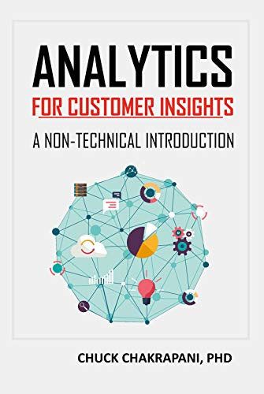
Worth a Review

Slide 14
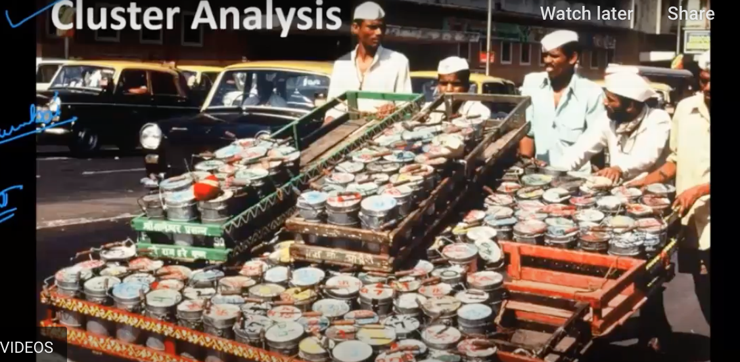

Do some exploring yourself!
Analytics& Insights
Cluster Analysis –click on the picture to learn more
Factor/Principal Component Analysis – PCA in 5 minutes

Slide 15

In our chat room, choose an analysis and briefly describe:
1. marketing issue
2. type of analysis
3. type of data
4. types of conclusions drawn based on the analysis
Your Turn

Slide 16

Analytics & Interpretation
Use the right tools…use the talents of your team
  Insights Team
  Statisticians
  Neuroscientists
  Ethnographers
  Communication specialists +++
Back to research objectives and management decision
Distill using key findings
Then consider
  So what?
  What’s next?
  What’s the Story?

Slide 17




Triangulation/ Convergence
Analytics& Insights

Slide 18

Building Insights
Inside their Heads
Many sources…unlikely from one source
“Strategic collection of data, thoughtful analytics & interpretation for texture and meaning” Jure Klepic

Slide 19

Building Insights: So What? What’s Next?
Strong functionality but slow uptake
Larger student share potential
High users love to be ahead of the curve
Chosen by only selective “SMART” users
Perceived to be complicated to use & explain
Trust it better if they discover themselves
Perceive students don’t trust teachers’ opinion
Perceive technology as short lived
Taking course of least resistance & perceived student ease of adoption
Students
Teachers

Slide 20

Insights
Analytics& Insights
Actionable
Convergence
Understanding to Influence Behaviour
Sustainable ..earn & keep trust
Notes:
I

Slide 21
Building Insights: So What? What’s Next?
Strong functionality but slow uptake
Larger student share potential
High users love to be ahead of the curve
Chosen by only selective “SMART” users
Ah Ha Moment:
Develop clear student-led discovery strategy where students peer mentor the use of the learning APP
Perceived to be complicated to use & explain
Trust it better if they discover themselves
Perceive students don’t trust teachers’ opinion
Perceive technology as short lived
Taking course of least resistance & perceived student ease of adoption
Students
Teachers

Slide 22


How are your feeling?
Analytics& Insights
Understand CAIP Canada competencies and responsibilities
Recognize applied nature of CAIP exam
Identify your strengths and areas for improvement
Refresh the exam writing skills
Practice, practice, practice
Build confidence
@AshTProductions/Shutterstock

Slide 23
Your Turn Now
Practice Questions Next!

Slide 24
What’s Up Next?
Quant Methods
Questionnaire Design
Analytics & Insights
Exam
Research Designs
Research Management
Project Proposal &
Critique
Qual Methods
Sampling
Ethics & Standards

